Slide 1

Interstate Affinity/International Relations Database
Alden Felix

Slide 2
Purpose
Inspired by Dr. Vito D'Orazio – predicted violent conflict in Africa using machine learning models
Wanted to generalize globally
Predict inter-state affinity with machine learning using socioeconomic and demographic data
Database to merge relevant data from multiple sources and large amount of event data

Slide 3

Coded Event Data
Integrated Crisis Early Warning System
ICEWS: Integrated Crisis Early Warning System from Harvard Dataverse from January 1, 1995, to April 11, 2023

Slide 4
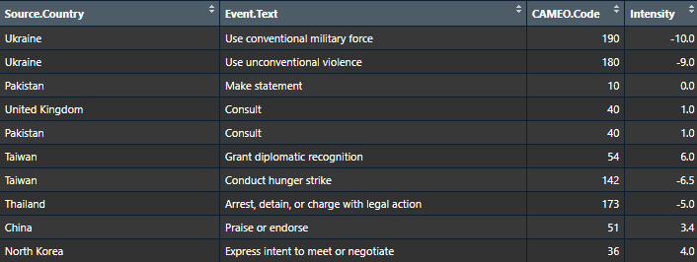
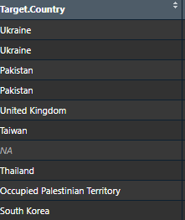
Coded Event Data

Slide 5
Socioeconomic Data/Independent Variables
World Bank
World Development Indicators
Education Statistics
Gender Statistics
Health Nutrition and Population Statistics
Doing Business (Objective measures of business regulations and their enforcement)
International Monetary Fund
Freedom House
Trade data
Freedom scores

Slide 6
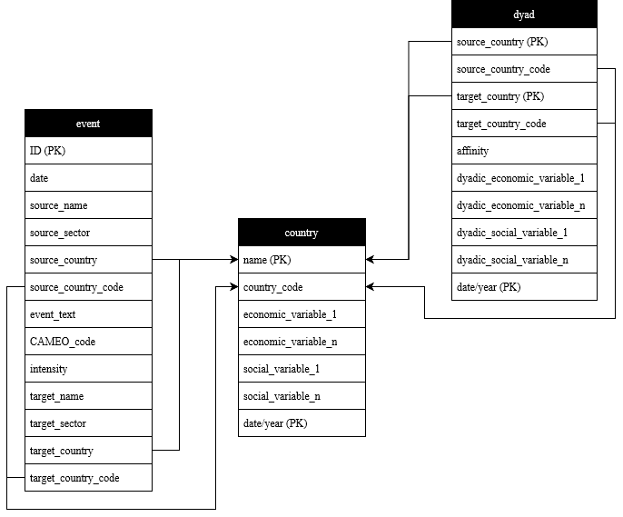
Initial Relation Schema

Slide 7
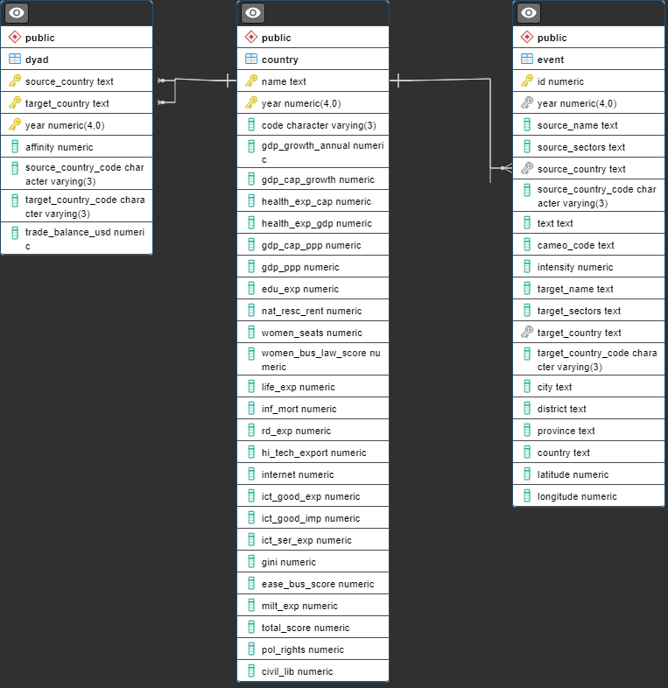
Final Relation Schema

